Slide 1
Jack Bertolus
Research Coordinator
B.Com/B.Sc (Monash)
Jack@marketforces.org.au

Slide 2
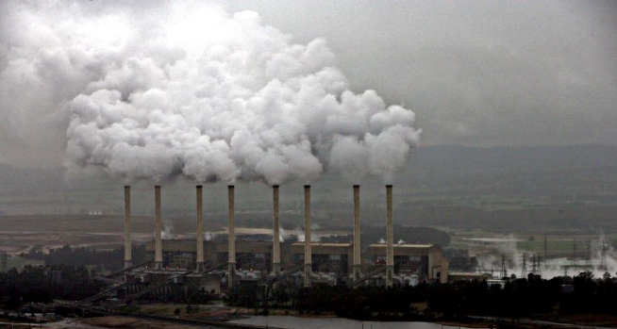
Who are Market Forces?
Affiliate project of:
Member of:
Exposing institutions that are financing environmentally destructive fossil fuel projects. Encourage better practice.

Slide 3
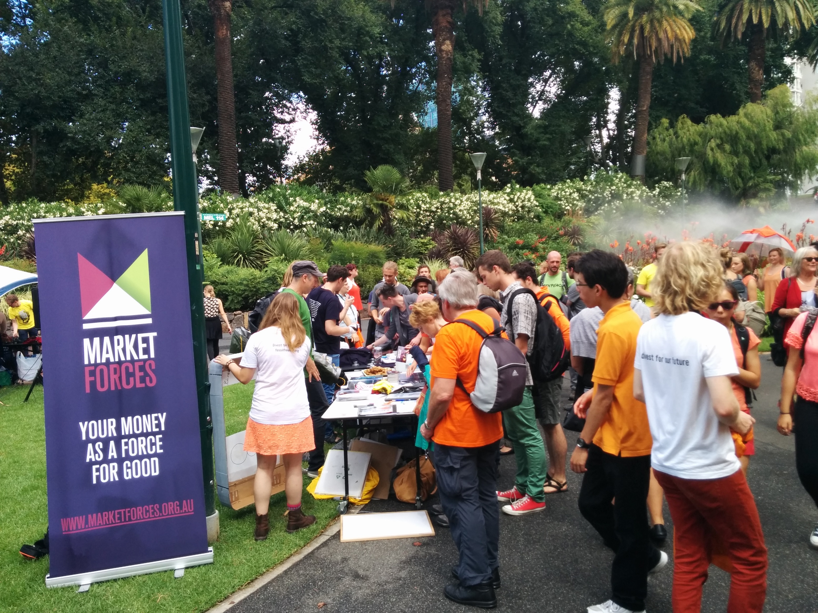
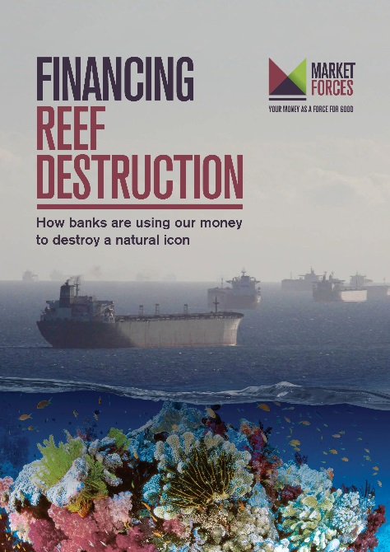
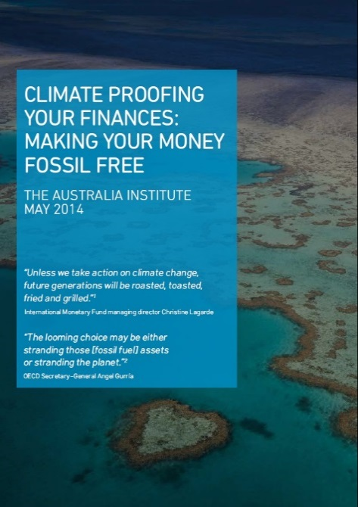
Where we work…

Slide 4
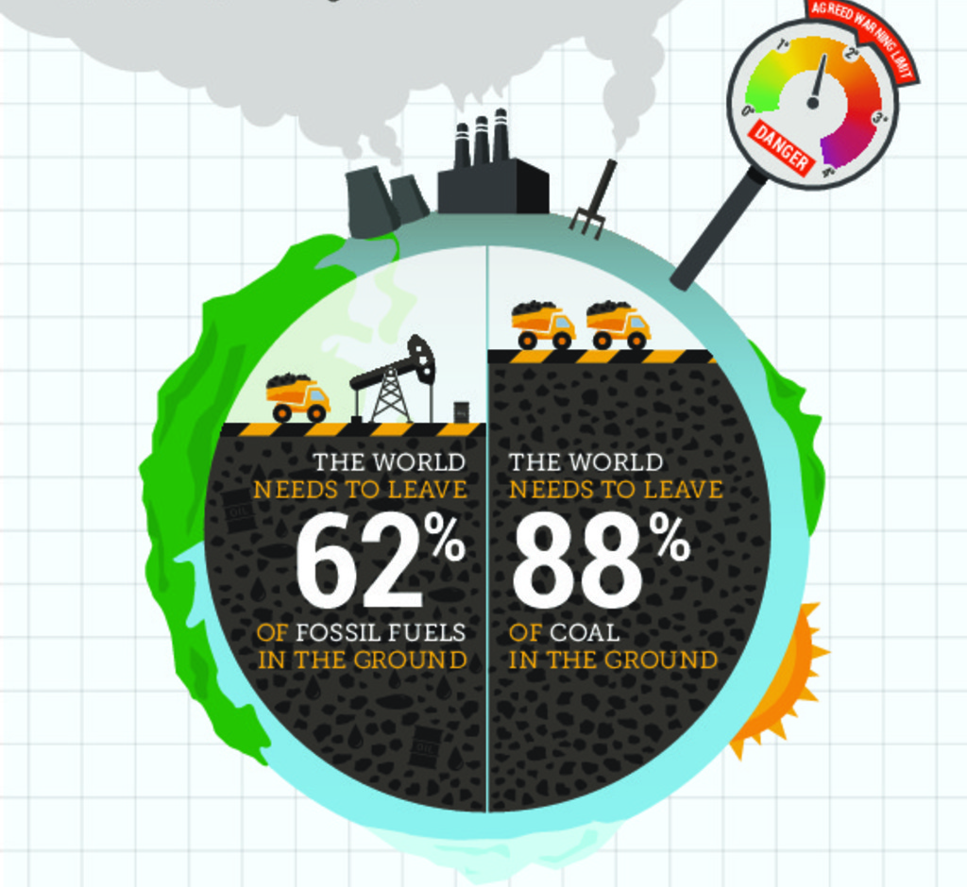
Carbon Budget
50% chance of avoiding 2°C:
Source: Steffen, W (Climate Council of Australia, 2015). Unburnable Carbon: why we need to leave fossil fuels in the ground.

Slide 5
Divestment
Opposite of investment
Moral/ethical
Strip social license
“If global ambitions to limit global warming to less than 2 degrees Celsius become a reality, many fossil fuel resources will become unburnable and their financial value will be dramatically reduced”
- Christine Tørklep Meisingset – Storebrand, $75 billion funds under management

Slide 6
Fracking finance
Bank loans
Financial advice
Arranging finance
Ownership (banks / super)
Insurance / underwriting
Interchange of key personnel

Slide 7
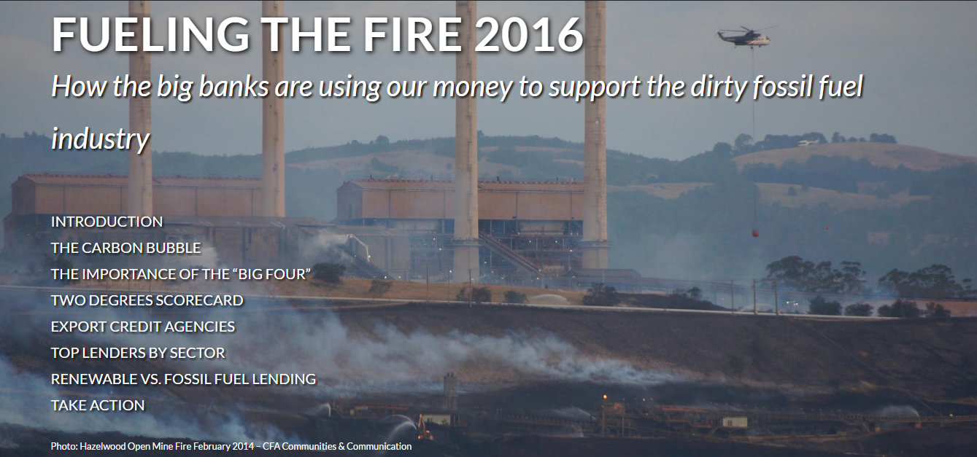
History of bank lending to fossil fuel industry
https://www.marketforces.org.au/fuelingthefire/

Slide 8
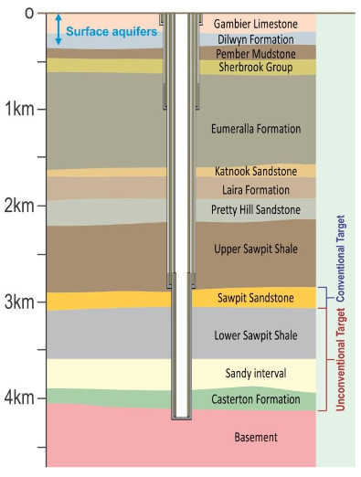
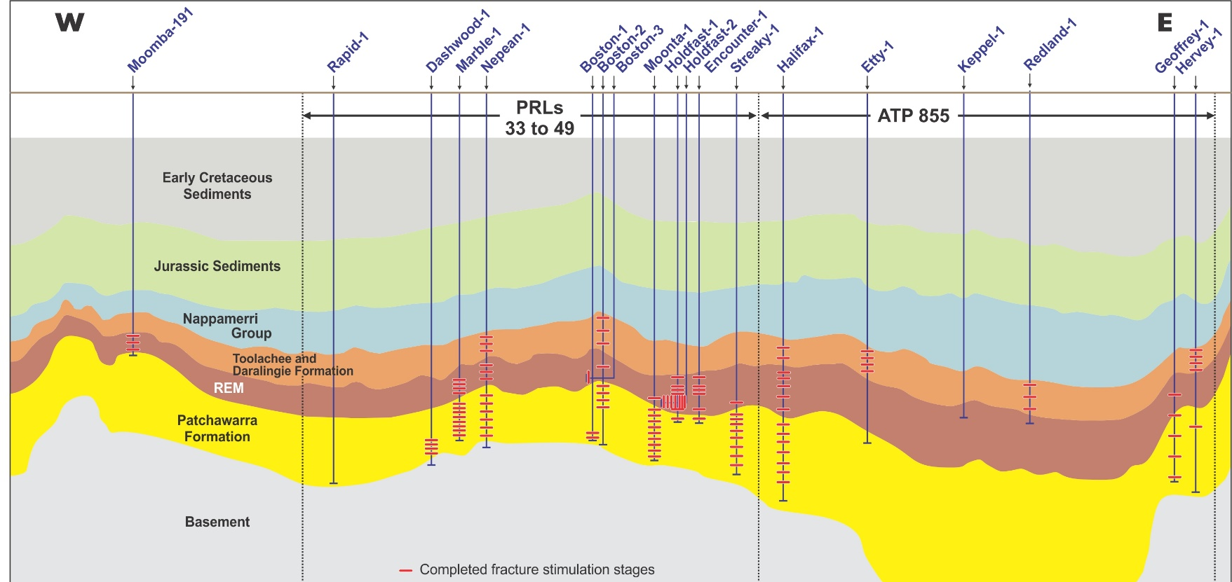
Otway un/conventional gas
Bungaloo-1 (C&S)
Jolly-1 (P&A)
Cooper unconventional gas

Slide 9
Fossil fuel exploration expenditure, 2012-2016
Australia | International | Total
$512m | $72m | $584m
Corporate loans since 2008
Political donations since FY11
ANZ | CBA | NAB | WBC
$288m | $438m | $150m | $0m
SA Liberals | $226,300
SA ALP | $50,000
Federal Liberals | $170,000
Total | $446,300
(Almost) all super invests

Slide 10
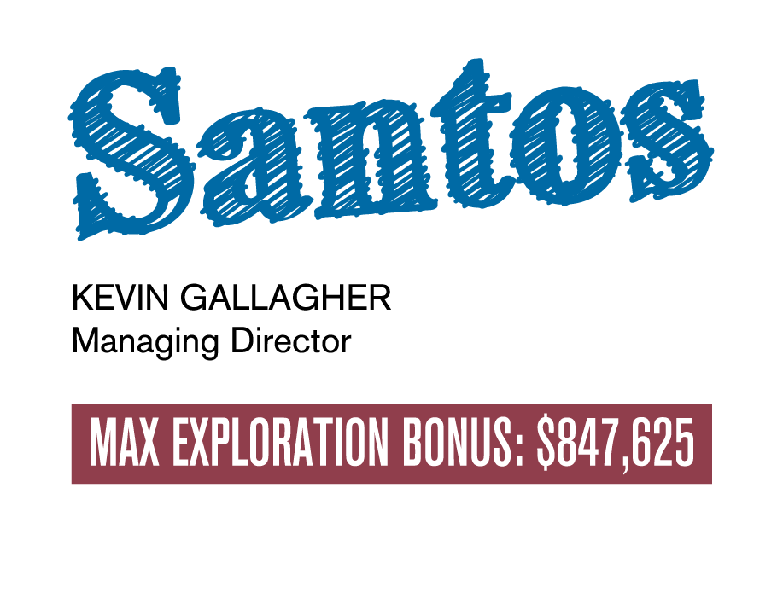
SuperSwitch.org.au/DiggingDeeper
Exploration expenditure by ASX Co’s, 12-16
Australia | International | Total
$4,464m | $8,221m | $12,685m

Slide 11
Divestment Movement is Global
In 15 months it grew by 68 times.

Slide 13
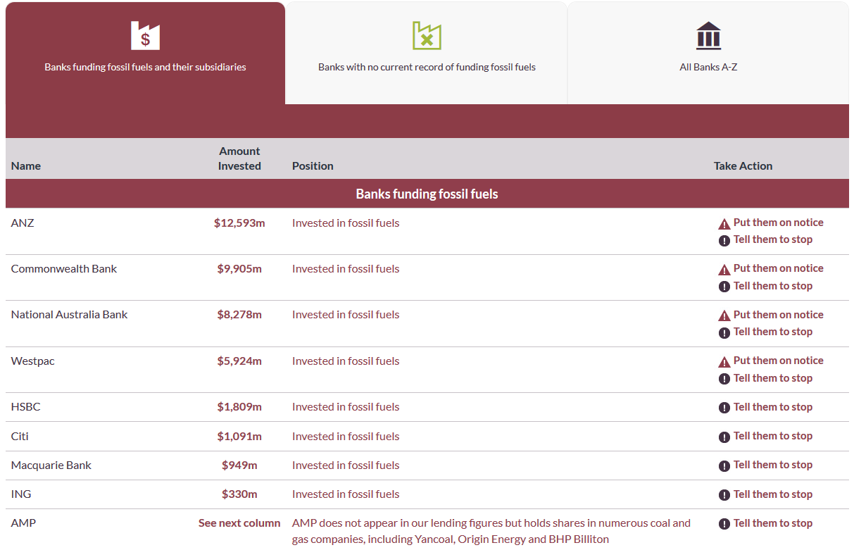
Banks Comparison Table
http://www.marketforces.org.au/banks/compare
Since 2008, the big four Australian banks – ANZ, CommBank, NAB and Westpac have loaned at least $50 billion to fossil fuel projects in Australia.
Take action
Tell them to stop
Banks on notice
How to Switch Banks and Make it Count

Slide 14
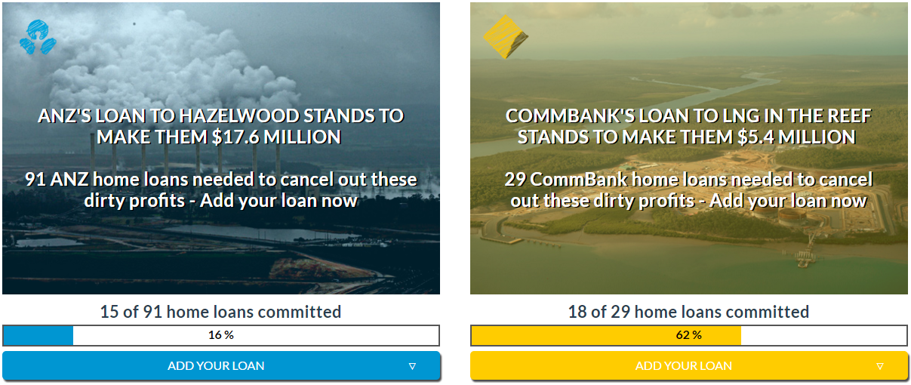
Notes:
Home loans

Slide 16
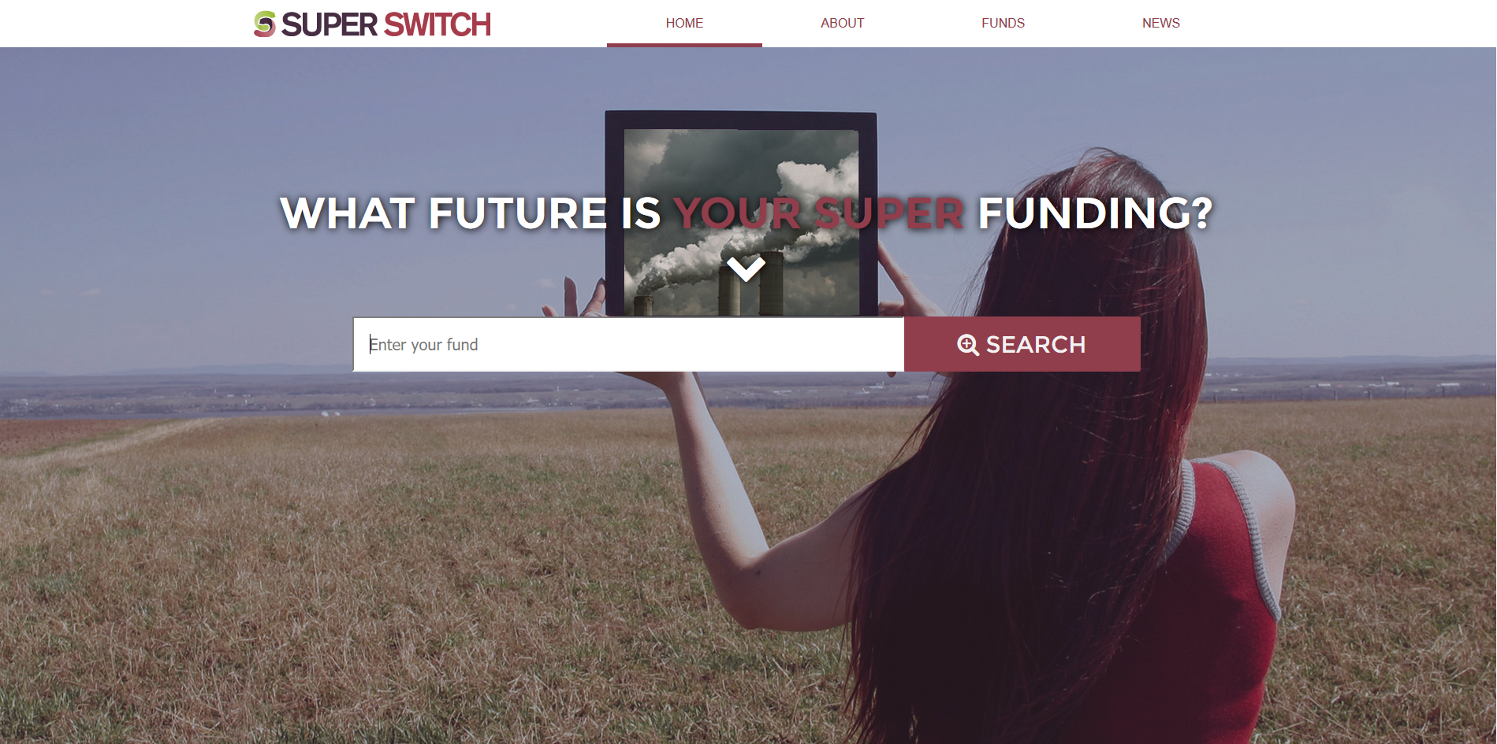
Super Switch
www.superswitch.org.au
SuperSwitch was launched in September 2014.
Identifies exposure to fossil fuels in 40 of Australia’s largest superannuation funds
Helps you take action!
Divest
Disclose
Browse other funds

Slide 17
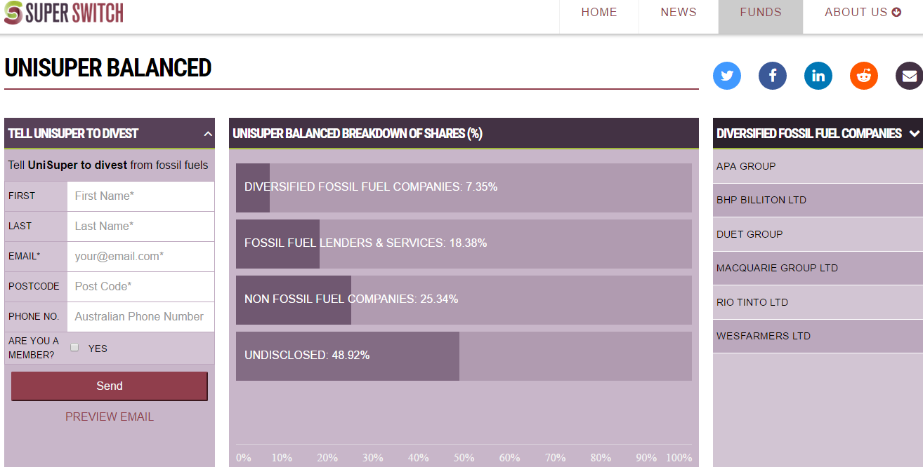
Notes:
Super Switch

Slide 18
Insurance
Notes:
Insurance

Slide 19
marketforces.org.au
superswitch.org.au
Jack Bertolus
Jack@marketforces.org.au

